Slide 1
SENTIMENT ANALYSIS TOOL USING AI BUILDER
SHRANYA GUPTA
2300290100238
3-D
CSE

Slide 2
ABOUT THE PROJECT
In this project, we use AI Builder in PowerAutomate to create a tool that helps us to analyse the sentiment of a sentence or a whole paragraph.
The output from the AI Builder is generated in the form of probabilities of the sentiments-Positive,Negative and Neutral.
These sentiments are then stored dynamically in an excel sheet in their respective columns.
The following slides give step-by-step explanation of this project.

Slide 3
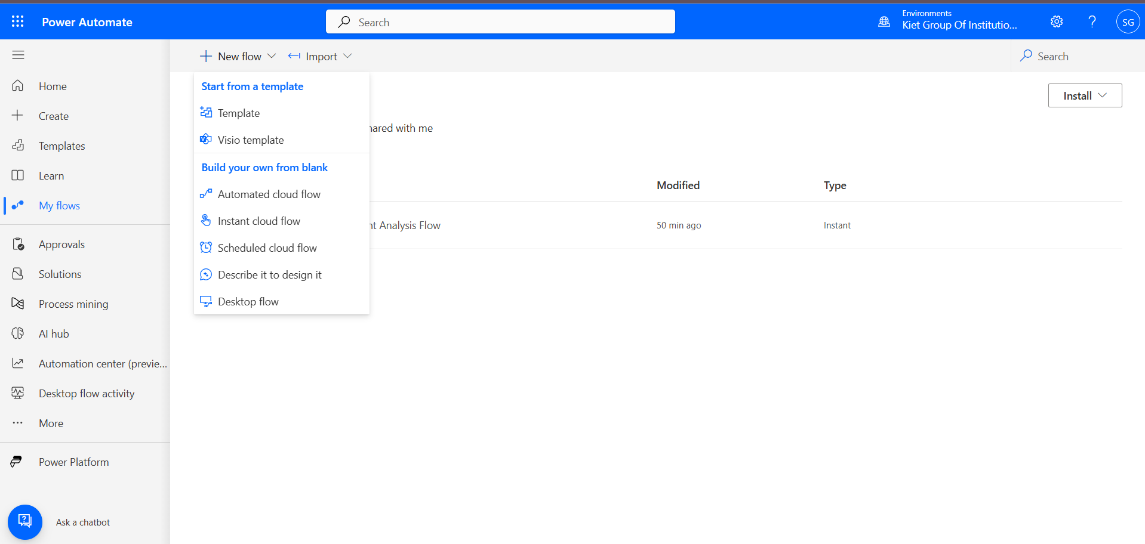
Create an account in PowerAutomate and select Instant Cloud Flow from New Flow in My Flow

Slide 4
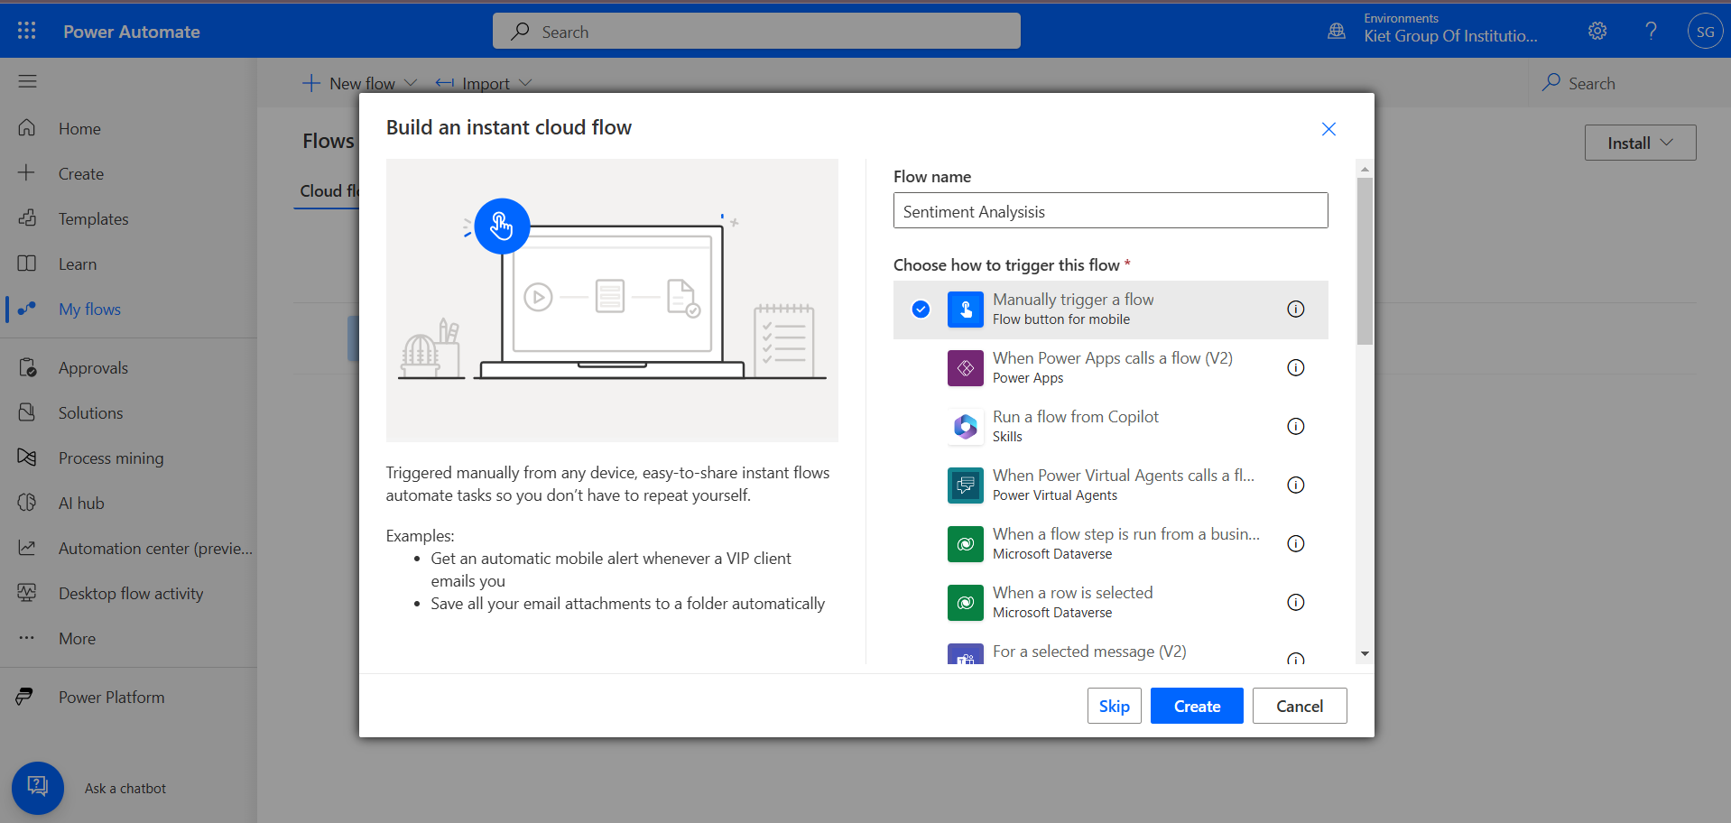
Choose a file name then select Manually Trigger a Flow. Click Create

Slide 5
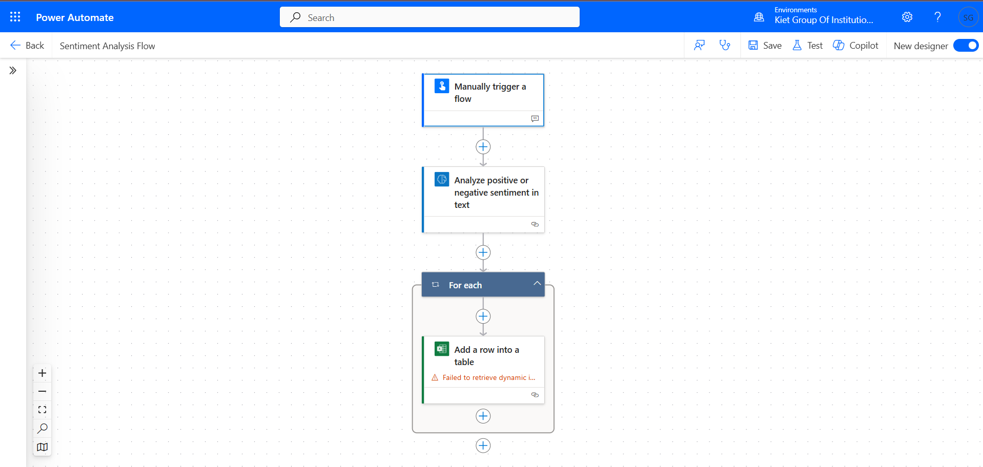
After creating a work flow for sentiment analysis, it will look like this

Slide 6
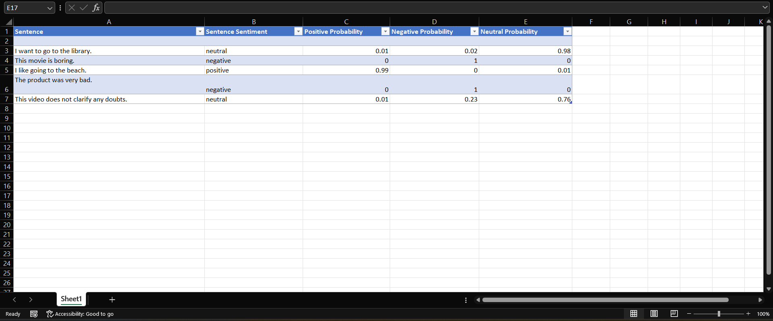
The excel file will input data dynamically from this workflow and will look like this.

Slide 7
CONCLUSION
This excel sheet will keep on recording the data as long as the user inputs a text.
This file saves all the probabilities of the sentiments in a text.
This tool is extensively used in studying Customer Satisfaction, filtering comments for social media sites and many more.

Slide 8
THANK
YOU

